Slide 1
Academic Senate
Adjunct Orientation
8/8/17

Slide 2
TITLE 5 § 53200 - DEFINITIONS
(B) Academic Senate means an organization whose primary function is to make recommendations with respect to academic and professional matters.
(C) Academic and Professional matters means the following policy development and implementation matters:
Notes:
Defined in Title 5 but not Education Code; note that the 2005 appellate court decision
recognized local senates as having legal standing

Slide 3
The “10 + 1”
Curriculum including establishing prerequisites and places courses within disciplines
Degree & Certificate Requirements
Grading Policies
Educational Program Development
Standards & Polices regarding Student Preparation and Success
College governance structures, as related to faculty roles
Faculty roles and involvement in accreditation process
Policies for faculty professional development activities
Processes for program review
Processes for institutional planning and budget development
Plus One: Other academic and professional matters as mutually agreed upon between the governing board and the academic senate

Slide 4
Two Adjunct Senators Needed for 2017/2018
Academic Senate meets the 1st, 3rd, and 5th Wednesday of the month b from 3 pm-4:30pm beginning August 16, 2017 – May 16, 2018
Submit a Letter of Interest

Slide 5
Accreditation
Accreditation Midterm Report due October 15, 2017
2nd Draft Available August, 2017
Final Draft goes to Board in September, 2017

Slide 6
SLOs
SLOs should be included on your syllabus
Still collecting SLO data every semester
http://www.valleycollege.edu/slocloud
Participation is needed to:
Improve Teaching and Learning
Meet Accreditation Standards
Compensation is available

Slide 7
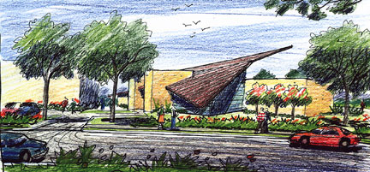
Celia Huston
Library 135
909-384-8574
cjhuston@valleycollege.edu

